Slide 1
^{Chapter 5} Tree
ZAMAN UNIVERSITY
Data Structures and Algorithms

Slide 2
Outline
Binary Trees
Traversing Binary Tree
Red-Black Trees
Red-Black Tree Insertions
2-3-4 Trees

Slide 3
Outline
Binary Trees
Traversing Binary Tree
Red-Black Trees
Red-Black Tree Insertions
2-3-4 Trees

Slide 4
Traversing the Tree
Traversing a tree means visiting each node in a specified order
There are three simple ways to traverse a tree: preorder, inorder, and postorder.
The order most commonly used for binary search trees is inorder
An inorder traversal of a binary search tree will cause all the nodes to be visited in ascending order, based on their key values.

Slide 5
Inorder Traversal
The simplest way to carry out a traversal is the use of recursion
A recursive function to traverse the tree is called with a node as an argument. Initially, this node is the root.
The function must perform only three tasks:
1. Call itself to traverse the node’s left subtree.
2. Visit the node.
3. Call itself to traverse the node’s right subtree.
C++ Code for traversing:
void inOrder(Node* pLocalRoot) {
if( pLocalRoot != NULL ){
inOrder(pLocalRoot->pLeftChild); //left child
cout << pLocalRoot->iData << “ “; //display node
inOrder(pLocalRoot->pRightChild); //right child
}
}

Slide 6
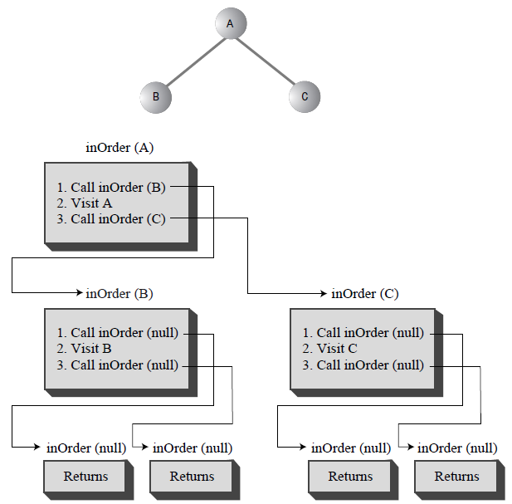
Traversing a 3-Node Tree

Slide 7
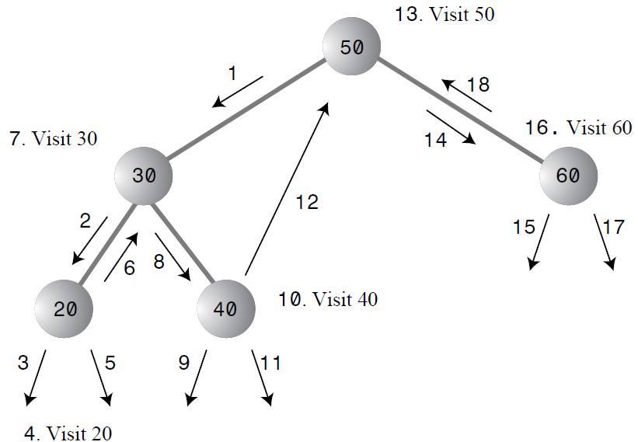
Example of Traversing a Tree Inorder

Slide 8
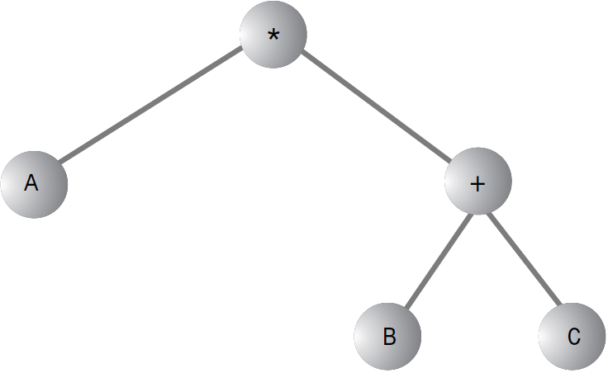
Preorder and Postorder Traversals
A binary tree (not a binary search tree) can be used to represent an algebraic expression
For example: algebraic expression A * ( B + C ) – this is called infix notation; it’s the notation normally used in algebra
Tree representing an algebraic expression:

Slide 9
Preorder and Postorder Traversals (cont.)
Preorder | Postorder
Preorder() member function: 1. Visit the node. 2. Call itself to traverse the node’s left subtree. 3. Call itself to traverse the node’s right subtree. | Postorder() member function: 1. Call itself to traverse the node’s left subtree. 2. Call itself to traverse the node’s right subtree. 3. Visit the node.
Prefix: * A + B C | Postfix: A B C + *
Prefix - Starting on the left, each operator is applied to the next two things in the expression. | Postfix - Starting on the right, each operator is applied to the two things on its left.
Apply: * to A and +BC, in turn the expression +BC mean apply + to B and C give us (B+C). Inserting that into the original expression *A+BC (preorder) gives us A*(B+C) . | Apply: 1. + to B and C give us (B+C); 2. * to A and (B+C) give us infix A*(B+C)

Slide 10
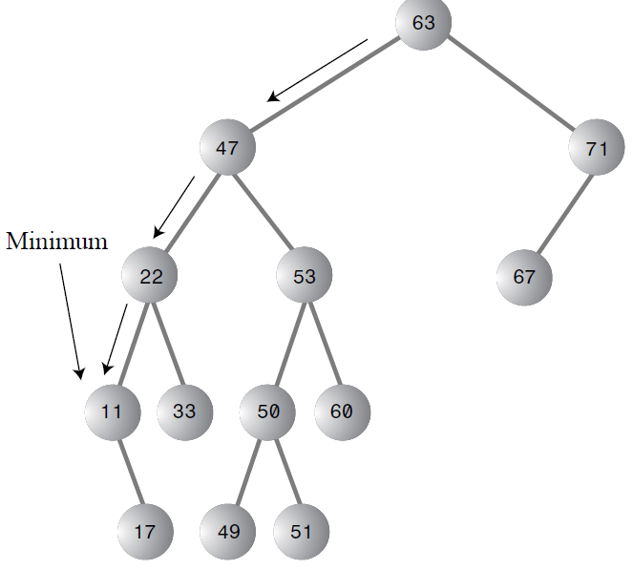
Finding Maximum and Minimum Values
Minimum value – go to the end of left child (node) of root;
Maximum value – go to the end of right child (node) of root;
Node* minimum() {
Node* pCurrent, pLast;
pCurrent = pRoot; //start at root
while(pCurrent != NULL){//until the bottom,
pLast = pCurrent; //remember node
//go to left child
pCurrent = pCurrent->pLeftChild;
}
return pLast;
}

Slide 11
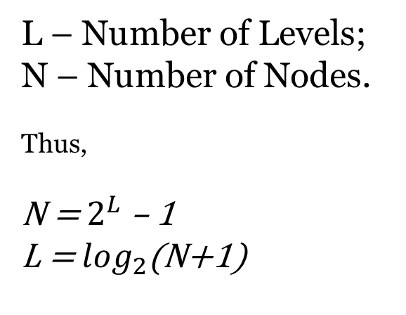
Efficiency of Binary Trees
Number of Nodes | Number of Levels
1 | 1
3 | 2
7 | 3
15 | 4
31 | 5
… | …
1,023 | 10
… | …
32,767 | 15
… | …
1,048,575 | 20
… | …
33,554,432 | 25
L – Number of Levels;
N – Number of Nodes.
Thus,
N = $2^{L}$ – 1
L = $\log_{2}$(N+1)

Slide 12
Outline
Binary Trees
Traversing Binary Tree
Red-Black Trees
Red-Black Tree Insertions
2-3-4 Trees

Slide 13
What is Red-Black Trees?
Binary Search Trees, if data is inserted in a non-random sequence, the tree might become unbalanced, seriously degrading its performance.
A Red-Black Tree can fix this by ensuring that the tree remains balanced at all times.

Slide 14
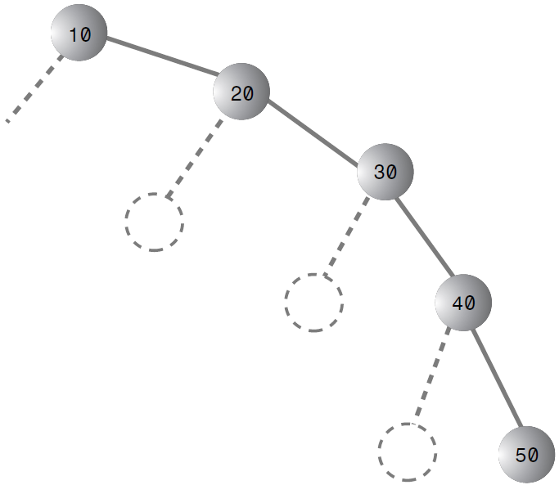
Balanced and Unbalanced Trees
During insertion a series of nodes whose keys are in either ascending or descending order, thus binary tree becomes unbalanced
With an unbalanced tree, the ability to quickly find (or insert or delete) a given element is lost
When there are no branches,
the tree becomes, in effect, a linked list.
With linked list, we need O(n/2) for searching

Slide 15
Balanced Trees to the Rescue
To guarantee the quick O(log N) search times a tree, we need to ensure that our tree is always balanced (or at least almost balanced)
This means that each node in a tree must have roughly the same number of children on its left side as it has on its right
In a red-black tree, balance is achieved during insertion and deletion.

Slide 16
Red-Black Tree Characteristics
Red-Black Tree Characteristics:
The nodes are colored;
During insertion and deletion, rules are followed.
Colored nodes, in Red-Black tree every node is either red or black.
Red-Black rules:
1. Every node is either red or black.
2. The root is always black.
3. If a node is red, its children must be black.
4. Every path from the root to a leaf, or to a null child, must contain the same number of black nodes.

Slide 17
The Actions
What actions can you take if one of the red-black rules is broken? There are two, and only two, possibilities:
You can change the colors of nodes.
You can perform rotations.
Try red-black tree on https://www.cs.usfca.edu/~galles/visualization/RedBlack.html

Slide 18
To be continued…

